Slide 1
Dynamic Programming

Slide 2
Steps of Dynamic Programming
1. Characterize the structure of an optimal solution.
2. Recursively define the value of an optimal solution.
3. Compute the value of an optimal solution in a bottom-up fashion.
4. Construct an optimal solution from computed information.

Slide 3
Matrix Chain Multiplication
The matrix-chain multiplication problem can be stated as follows:
Given a chain A₁, A₂,. . . , An of n matrices, where for i = 1, 2, . . . , n, matrix A_{i} has dimension p_{i−1} × p_{i} , fully parenthesize the product A₁ A₂ · · · A_{n} in a way that minimizes the number of scalar multiplications.

Slide 4
Matrix Chain Multiplication…
A product of matrices is fully parenthesized if it is either a single matrix or the product of two fully parenthesized matrix products, surrounded by parentheses.
Matrix multiplication is associative, and so all parenthesizations yield the same product. For example, if the chain of matrices is A₁, A₂, A₃, A₄, the product A₁ A₂ A₃ A₄ can be fully parenthesized in five distinct ways:
(A₁(A₂(A₃ A₄))) ,
(A₁((A₂ A₃)A₄)) ,
((A₁ A₂)(A₃ A₄)) ,
((A₁(A₂ A₃))A₄) ,
(((A₁A₂)A₃)A₄) .

Slide 5
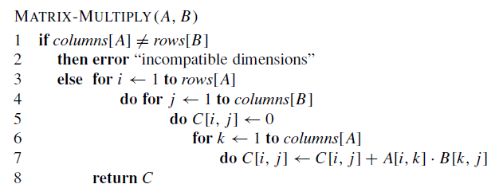
Algorithm for Matrix Multiplication
If A is a p ×q matrix and B is a q ×r matrix, the resulting matrix C is a p ×r matrix.
The time to compute C is dominated by the number of scalar multiplications in line 7, which is pqr.

Slide 6
Different Costs of parenthesizations
To illustrate the different costs incurred by different parenthesizations of a matrix product, consider the problem of a chain A₁, A₂, A₃ of three matrices.
Suppose that the dimensions of the matrices are 10 × 100, 100 × 5, and 5 × 50, respectively.
((A1 A2)A3) causes 7500 scalar multiplications.
(A1(A2 A3)) causes 75000 scalar multiplications

Slide 7
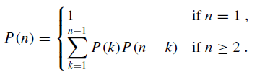
Counting the number of parenthesizations
Let P(n) denotes the number of alternative parenthesizations of a sequence of n matrices.
When n ≥ 2, a fully parenthesized matrix product is the product of two fully parenthesized matrix subproducts, and the split between the two subproducts may occur between the kth and (k + 1)st matrices for any k = 1, 2, . . . , n − 1. Thus, we obtain the recurrence

Slide 8
Step1: The structure of an optimal parenthesization
The optimal substructure of this problem is as follows.
Suppose that an optimal parenthesization of A_{i} A_{i+1 · · ·} A_{j} splits the product between A_{k} and A_{k+1}.
Then the parenthesization of the “prefix” subchain A_{i} A_{i+1 · · ·} A_{k} within this optimal parenthesization of A_{i} A_{i+1 · · ·} A_{j} must be an optimal parenthesization of A_{i} A_{i+1 · · ·} A_{k .}
Why?
If there were a less costly way to parenthesize A_{i} A_{i+1 · · ·} A_{k} , substituting that parenthesization in the optimal parenthesization of A_{i} A_{i+1} · · · A_{j} would produce another parenthesization of A_{i} A_{i+1} · · · A_{j} whose cost was lower than the optimum: a contradiction.

Slide 9
Step 2: A recursive solution
Let m[i, j ] be the minimum number of scalar multiplications needed to compute the matrix A_{i.. j} ; for the full problem, the cost of a cheapest way to compute A_{1..n} would thus be m[1, n].
Let us assume that the optimal parenthesization splits the product A_{i} A_{i+1} · · · A_{j} between A_{k} and A_{k+1}, where i ≤ k < j . Then, m[i, j] is equal to the minimum cost for computing the subproducts A_{i..k} and A_{k+1.. j}, plus the cost of multiplying these two matrices together.
m[i, j ] = m[i, k] + m[k + 1, j ] + p_{i−1} p_{k} p_{j}

Slide 10

Step 2: A recursive solution
Recursive equation assumes that we know the value of k, which we do not.
There are only j −i possible values for k, however, namely k = i, i +1, . . . , j −1.
Since the optimal parenthesization must use one of these values for k, we need only check them all to find the best.
Thus, our recursive definition for the minimum cost of parenthesizing the product A_{i} A_{i+1} · · · A_{j} becomes

Slide 11
Step3: Computing the optimal costs
We perform the third step of the dynamic-programming paradigm and compute the optimal cost by using a tabular, bottom-up approach.
The following pseudocode assumes that matrix A_{i} has dimensions p_{i−1} × p_{i} for i = 1, 2, . . . , n. The input is a sequence p = p₀, p₁, . . . , p_{n}, where length[p] = n + 1.
The procedure uses an auxiliary table m[1 . . n, 1 . . n] for storing the m[i, j ] costs and an auxiliary table s[1 . . n, 1 . . n] that records which index of k achieved the optimal cost in computing m[i, j ].
We will use the table s to construct an optimal solution.

Slide 12
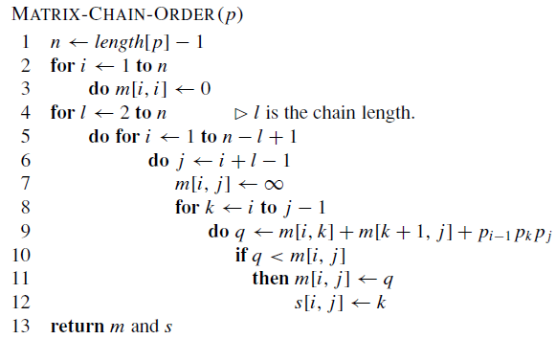
Step3: Computing the optimal costs…

Slide 13
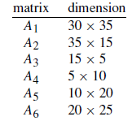
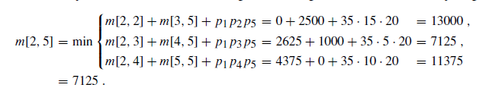
Step3: Computing the optimal costs…

Slide 14
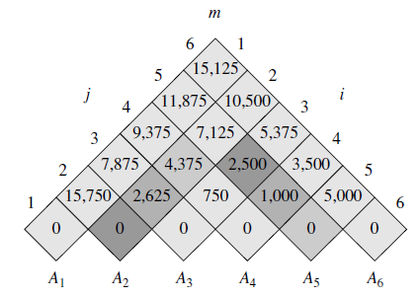
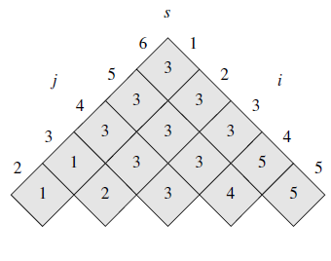

Slide 15
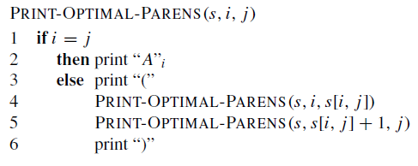
Step 4: Constructing an optimal solution
Initial call PRINT-OPTIMAL-PARENS(s, 1, 6) prints the parenthesization ((A1(A2A3))((A4A5)A6)).

Slide 16
Longest common subsequence
A subsequence of a given sequence is just the given sequence with zero or more elements left out.
Formally, given a sequence X = <x₁, x₂, . . . , x_{m}>, another sequence Z = < z₁, z₂, . . . , z_{k} >is a subsequence of X if there exists a strictly increasing sequence < i₁, i₂, . . . ,i_{k}> of indices of X such that for all j = 1, 2, . . . , k, we have x_{i} _{j}= z _{j} .
For example, Z = < B, C, D, B > is a subsequence of X =
< A, B,C, B, D, A, B > with corresponding index sequence 2, 3, 5, 7.

Slide 17
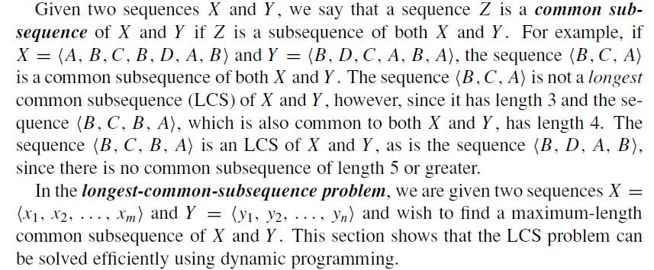
Longest common subsequence

Slide 18
Step 1: Characterizing a longest common subsequence
Assumption: To be precise, given a sequence X = <x₁, x₂, . . . , x_{m}>, we define the i^{th} prefix of X, for i = 0, 1, . . . ,m, as X_{i} = x₁, x₂, . . . , x_{i} .
For example, if X = A, B, C, B, D, A, B, then X₄ = A, B,C, B and X₀ is the empty sequence.

Slide 19
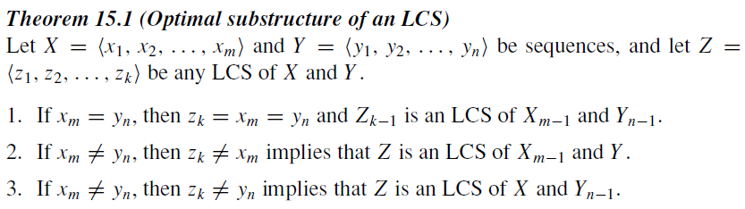
Step 1: Characterizing a longest common subsequence

Slide 20
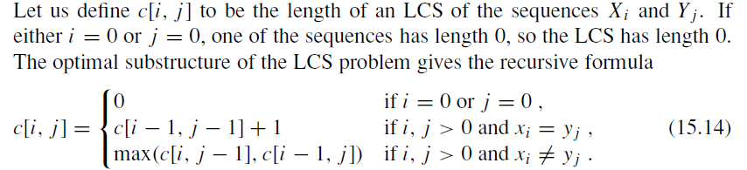
Step 2: A recursive solution

Slide 21
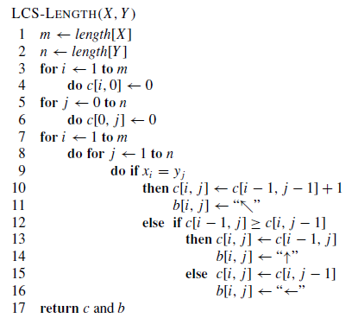
Step 3: Computing the length of an LCS

Slide 22
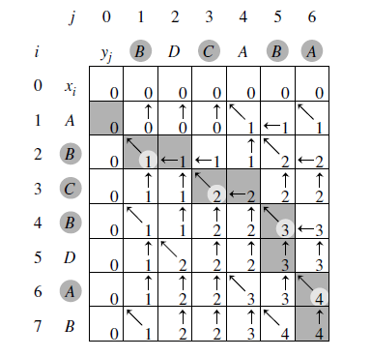
Step 3: Computing the length of an LCS

Slide 23
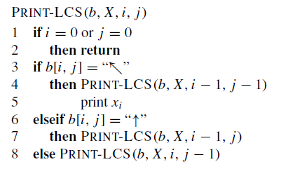
Step 4: Constructing an LCS
The initial invocation is PRINT-LCS(b, X, length[X], length[Y ]).

